Slide 1
Agenda
Jiří KROL
10.2.2016
CLOs
Liquid Alternatives
UCITS funds
Basel III

Slide 2
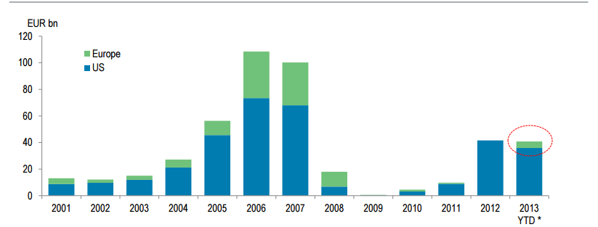
The opportunity in Europe for CLO financed growth is significant
European vs. US CLO issuance – the US is still 10 times as large on current trends

Slide 3
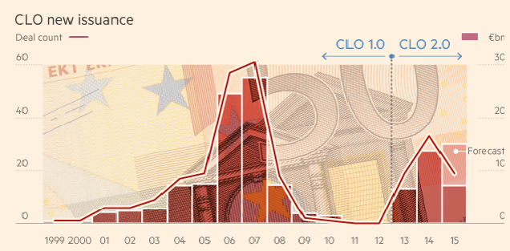
But Europe is picking up…
European CLO issuance peaked in 2007 at €27.6bn
After 5 years of market closure they are now picking up
Estimates for 2015 are for in excess of €15bn up from €13.7bn in 2014 and €6.6bn in 2013.
With continuing uncertainty in the US over Volcker, there is an opportunity to increase investment in Europe

Slide 4
How Investment Fund CLOs can increase finance for SMEs
SME
AIFM
Capital Markets
Investors
Loans
Money
Units
SME
1
Sponsor
Money
AIF/ELTIF
CLO
SME
2
Loans securitised
Investors
SME
Bonds
1
Loan fund lends money to SMEs
These loans are securitised into an investment fund CLO with AIFM as sponsor + retainer
Long-term institutional investors invest in the CLO
SMEs now part of CMU
SME
4
4

Slide 5
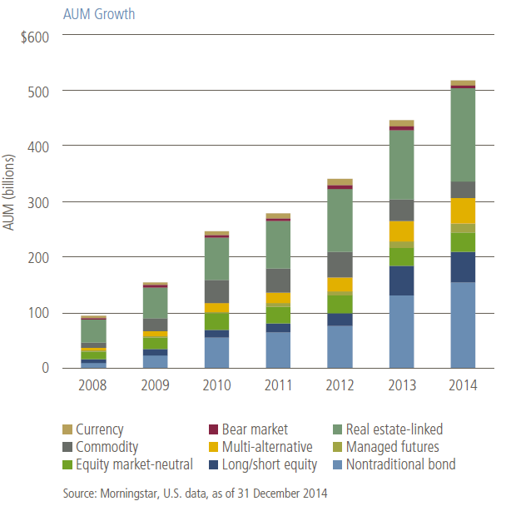
What are Liquid Alternatives?
Not all alternative investments can be found in liquid format
  For example, private equity or distressed debt are not common objectives for liquid funds
  AUM combines mutual funds and ETFs
Source: PIMCO, “Liquid Alternatives: Considerations for Portfolio Implementation,” September 2015

Slide 6
Complexity vs. Prior Access
More complex products that were not previously available to retail investors are the focus of liquid alternative investors
Definitely Liquid Alts | Potentially Liquid Alts | Not Liquid Alts
Hedge Fund Strategies | Long-only Non-Traditional Bonds with Floating Rate or Bank Loan Holdings | Long-only Equity Funds, including Smart Beta and Fundamental Indexing
Managed Futures Strategies | Currency Funds | Long-only Equity Sector Funds, including Infrastructure and Commodity Stocks
Multi-manager Hedge Fund Strategies | Commodity Futures and Physicals | Long-only Balanced Funds, including Tactical Asset Allocation and Target-Date Funds
Non-traditional Bond Funds with Short and/or Derivatives Positions | Traded Business Development Companies (BDCs)
Volatility ETPs | Traded REITs
 | Traded MLPs
 | Levered/Inverse ETPs
 | Separate Accounts Holding Levered, Short, and/or Derivatives Positions

Slide 7
The attraction of UCITS funds
    Assets in traditional offshore hedge fund structures stood at $500bn in 1H 2015, up from $480B at the start of 2015
    Adding the $180bn in assets run in UCITS-compliant hedge funds, the total European hedge fund asset figure rises to $680bn, a new high water mark for the European hedge fund market
    Managers continue to tap the UCITS sector using a combination of standalone funds and UCITS platforms
    Growth in 2014 has continued in the UCITS sector with AUM increasing 40%
    UCITS sector growth has come from Equity L/S, Event, Credit, Macro and Market Neutral in 2015
Hedge fund CAGR (2009 – 1H 2015): 5.1%
UCITS funds CAGR (2009 – 1H 2015): 45.2%
Source: Eurohedge, September 2015

Slide 8
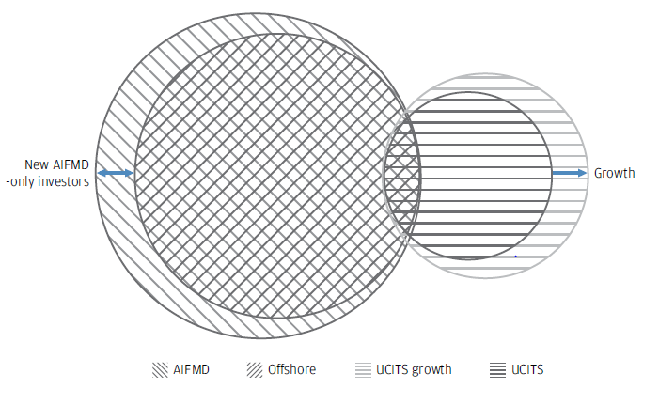
The attraction of UCITS funds
Supply and demand factors influencing the development of the UCITS Absolute return sector
The financial crisis highlighted the fragility of the traditional hedge fund business model
The prolonged negotiation of the AIFM Directive created considerable uncertainty around marketing
Fund governance became a more prominent priority for investors
During the financial crisis fund of hedge funds suffered significant outflows – several sought to tap the UCITS investor base to replenish these funds
Absolute return funds represented an unmet need for existing UCITS investors
The European investor base for offshore, AIFMD and UCITS absolute return funds
Anecdotally managers generally observe low levels of cannibalisation between offshore funds and their UCITS counterparts
Source: Europe from A to U, JP Morgan July 2015
* J.P. Morgan Capital Introduction and internal Legal Counsel, July 2015

Slide 9
Basel III framework
Leverage | A non-risk-based leverage ratio that includes off-balance sheet exposures will serve as a backstop to risk-based capital requirements. Also designed to help contain system wide build-up of leverage.
Liquidity | Liquidity coverage ratio: The liquidity coverage ratio (LCR) will require banks to have sufficient high-quality liquid assets to withstand a 30-day stressed funding scenario that is specified by supervisors. The net stable funding ratio (NSFR) is a longer-term structural ratio designed to address liquidity mismatches and reduce reliance on short-term wholesale funding. It covers the entire balance sheet and provides incentives for banks to use stable sources of funding.
Capital | Quality and level of capital: Greater focus on common equity. The minimum will be raised to 4.5% of risk-weighted assets, after deductions. Capital loss absorption at the point of non-viability: Contractual terms of capital instruments will include a clause that allows ― at the discretion of the relevant authority ― write-off or conversion to common shares if the bank is judged to be non-viable. This principle increases the contribution of the private sector to resolving future banking crises and thereby reduces moral hazard. Capital conservation buffer: Comprising common equity of 2.5% of risk-weighted assets, bringing the total common equity standard to 7%. Constraint on a bank’s discretionary distributions will be imposed when banks fall into the buffer range. Countercyclical buffer: Imposed within a range of 0-2.5% comprising common equity, when authorities judge credit growth is resulting in an unacceptable build-up of systematic risk.
Risk coverage | Securitisations: Strengthens the capital treatment for certain complex securitisations. Requires banks to conduct more rigorous credit analyses of externally rated securitisation exposures. Trading book: Significantly higher capital for trading and derivatives activities, as well as complex securitisations held in the trading book. Introduction of a stressed value-at-risk framework to help mitigate procyclicality. A capital charge for incremental risk that estimates the default and migration risks of unsecuritised credit products and takes liquidity into account. Counterparty credit risk: Substantial strengthening of the counterparty credit risk framework. Includes: more stringent requirements for measuring exposure; capital incentives for banks to use central counterparties for derivatives; and higher capital for inter-financial sector exposures. Bank exposures to central counterparties (CCPs): The Committee has proposed that trade exposures to a qualifying CCP will receive a 2% risk weight and default fund exposures to a qualifying CCP will be capitalised according to a risk-based method that consistently and simply estimates risk arising from such default fund.

Slide 10
AIMA/S3 survey
August/September: AIMA/S3 survey of broad cross-section of 78 alternative asset managers, representing a diverse range of AUM size, investment strategies, and geography. The
combined AUM of survey respondents exceeded $400bn.
Notes:
Intentions that underlie CMU are pretty well understood. This is Commissioner Hill’s flagship project. It’s about broadening the range of funding sources for businesses in Europe. You could also say that it’s about reducing Europe’s dependence on the banking sector, although the Commission has to walk a bit of a balancing act on that and try and present banks as part of the solution.
AIMA as an association has been very vocal in our support for the goals of the CMU project. We published a research paper last year exploring the linkages between capital market depth and economic growth levels and we’ve since published follow up studies exploring the specific contributions to economic activity made by credit funds and activist funds.
So it’s good to see that the project is advancing and as I said, the Commission has now come out with a package of measures in order to deliver CMU.
Package that came out at the end of September comprises several discrete piece of work. The commission describes it as “range of steps whose impact will cumulatively be significant”. To a certain degree there is an element here of trying to weave together quite unrelated pieces of work into a grand unifying theme, when the reality is that the individual components of the package are not necessarily earth shattering.
But still I would say that there is definitely enough substance here to view this as a serious undertaking; I don’t think this is going to end up being one of those Big Society ideas that has a catchy project title but little in the way of content

Slide 11
January 2016: Research report
Accessing the financial power grid:
Hedge fund financing challenges under Basel III and beyond
Notes:
Intentions that underlie CMU are pretty well understood. This is Commissioner Hill’s flagship project. It’s about broadening the range of funding sources for businesses in Europe. You could also say that it’s about reducing Europe’s dependence on the banking sector, although the Commission has to walk a bit of a balancing act on that and try and present banks as part of the solution.
AIMA as an association has been very vocal in our support for the goals of the CMU project. We published a research paper last year exploring the linkages between capital market depth and economic growth levels and we’ve since published follow up studies exploring the specific contributions to economic activity made by credit funds and activist funds.
So it’s good to see that the project is advancing and as I said, the Commission has now come out with a package of measures in order to deliver CMU.
Package that came out at the end of September comprises several discrete piece of work. The commission describes it as “range of steps whose impact will cumulatively be significant”. To a certain degree there is an element here of trying to weave together quite unrelated pieces of work into a grand unifying theme, when the reality is that the individual components of the package are not necessarily earth shattering.
But still I would say that there is definitely enough substance here to view this as a serious undertaking; I don’t think this is going to end up being one of those Big Society ideas that has a catchy project title but little in the way of content

Slide 12
Costs increasing
Change in financing costs?
Last 2 years
Coming 2 years (expected)
Most expect increase of up to 10% … although many think it could be more

Slide 13
Relationship changing
2/3+ | Asked to decrease free cash balances
1/3 | Asked to move a portion of their book to swap
1/3 | Asked to change type of collateral posted
5 – 15% | Some combination of terminate relationship, reduce leverage, focus on easier to finance securities and/or increase portfolio turnover
Notes:
There is a proposal on securitisations, which is probably the headline measure stemming from CMU.
There is a proposal to amend Solvency II. The Commission is looking to adjust the risk weightings of insurers’ exposures to infrastructure investments. That would make the capital treatment of infrastructure investments more favourable from a Solvency II perspective, so could increase financing from the insurance sector.
Obviously that’s a much more targeted policy intervention than say the securitisations piece, but it will be interesting to see whether it’s ultimately the smaller regulatory tweaks that deliver the biggest impact.
It’s also quite a good illustration of the interplay between EU regulation. While if you look at the ELTIFs concept in isolation it might not seem particularly exciting, but it’s within the Commission’s gift to make it much more relevant by playing around with how ELTIF investments are viewed in other pieces of legislation.
Back to the overall CMU package. We’re also promised further policy proposals by the end of this year on the prospectus directive. The Commissions says that it will look at the situations in which a prospectus is required, whether it might be possible to streamline the approval process, whether the information requirements for prospectuses could be simplified. On the face of it that sounds pretty promising. As ever I expect there’s going to have to be some sort of balancing act on the part of the Commission, in as much as it will still have to keep in mind the overall investor protection focus of prospectus requirements.
There is a consultation on European venture capital and social entrepreneurship funds that will explore whether the Commission can increase the take up of these vehicles. For example, should they amend the minimum $100,000 investment; should they change who can invest in these; should they open these up to third-country managers? If you were going to criticise the Commission on this one, you could say that they’re slightly too keen on creating different flavours of fund vehicles in EU, rather than just keeping things simple and revisiting what can be done under the UCITS and AIFMD frameworks.
There is a consultation on EU covered bond markets – so the Commission is exploring whether it could make this market work more effectively with more consistent pan-EU rules and greater standardisation. I get the sense that they’re shying away from bond market standardisation more broadly, which was a topic that was also addressed in the Bank of England’s Fair and Effective Markets Review. Probably wisely so, given that issuers are quite anti standardisation, even if investors are quite pro.
And then finally there is a consultation on EU regulatory framework for financial services, which offers an opportunity to comment on the various post-crisis regulatory measures.
The Commission says it is keen to hear what people are experiencing in terms of constraints on financing arising from regulation. Whether market liquidity has been impacted by reforms. How firms are dealing with cost and complexity and specifically whether reporting rules are proving problematic. It also focuses on definitions across legislation and potential gaps and overlaps.
It’s good to see that the Commission is open to feedback from market participants regarding the impact of the rules. That said, it’s not promising anything. It’s a pretty superficial consultation document and the Commission says it “may consider taking action in specific areas if the evidence gathered clearly demonstrates there are disproportionate costs or deficiencies”.
Personally I’m not sure all that much is going to come of this, given that Europe doesn’t have a particularly strong track record on strong cost benefit analysis underpinning policy measures. That said I’m sure there are problems that we’ll want to address in response to that. And I think if there were issues that could properly substantiate then you might get a sympathetic hearing from the EU. I suspect that CRD/CRR might be areas where there is more appetite for change, similar to the gradual softening of some of Solvency II standards.

Slide 14
Tel: +44 (0)20 7822 8380
Email: info@aima.org
Web: www.aima.org

